Slide 1
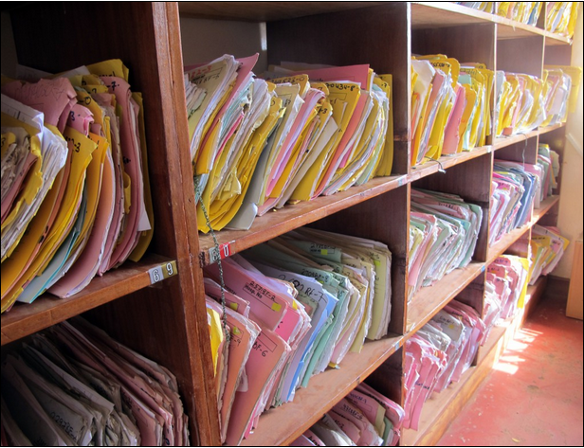
Computing and Global Health Lecture 4 Medical Record Systems
Winter 2015
Richard Anderson

Slide 2
Today’s topics
Paper to Digital, Nicki Dell
Readings and assignments
Medical Records in the US
Global context
Open MRS
iSante
General discussion

Slide 3
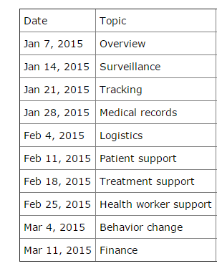
Readings and Assignments
Homework 3
Fahad!
Readings
Implementing electronic medical record systems in developing countries
Clinical decision support challenges
Open MSR

Slide 4
Assignment 4
Install the standalone instance of OpenMRS from http://openmrs.org/download/
Configure OpenMRS for use by Madam Pomfrey at Hogwarts Infirmary
Write a review of the 2005 “Implementing electronic medical record systems in developing countries” paper by Hamish Fraser et al. Assess how well this paper has withstood the test of time. How much of the paper is still relevant in 2015?
Expected length: one or two pages.

Slide 5
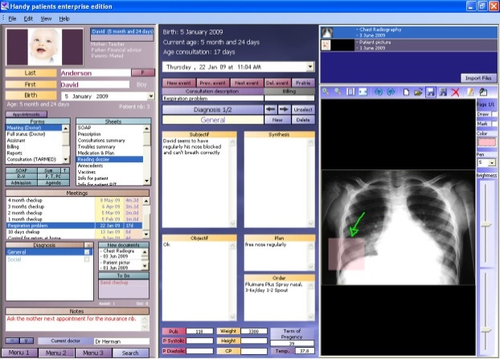
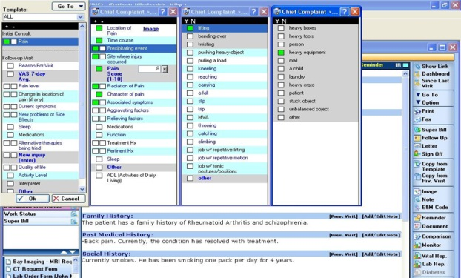
Electronic Medical Records
Developed world context
Paper versus electronic records
Multiple views
Container for holding information about patient
Tool for aggregating information for secondary uses (billing, test management)
Source of data for monitoring an reporting
In US
Many different products available
$$$$

Slide 6
Medical Records in the US
Hospitals / Clinics slow to adopt
2008 use, about 20%
IT Spending in Healthcare is low (2%)
Growing mandates for use
Medicare fines
HITECH incentives
Debates on cost savings
Issues about security and privacy

Slide 7
9 Reasons Doctors Hate EMRs
Time-Consuming Data Entry
User Interfaces That Do Not Match Clinical Workflow
Interference with Face-to-Face Care
Insufficient Health Information Exchange (difficulties in communicating with other systems, still sending faxes)
Information Overload
Mismatch Between Meaningful-Use Criteria and Clinical Practice (MUC – requirement to show the system is used)
EHRs Threaten Practice Finances
EHRs Require Physicians to Perform Lower-Skilled Work
Template-Based Notes Degrade the Quality of Clinical Documentation

Slide 8
EMR Summary
Some clear advantages
Information available to health care providers
Simplification of some actions
Possibility of a patient sharing information across providers
However
Disruptive to care process
Mismatch of benefits
Component of larger change to health care system

Slide 9
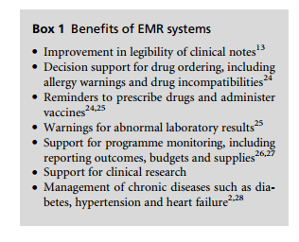
Benefits of Electronic Medical Records
Ease of locating
Legibility
Validity checks
Data extraction for research
Link to external information relevant to health status (e.g., documents on drug interactions)
Data available to multiple users
Safe backup

Slide 10
Key considerations for EMRs
Usability and Use in Clinic Workflow
Improvement of patient care and health system operation
Implication on organizational structure
Technology: robustness, accuracy, security, privacy

Slide 11
Medical Record Systems in Developing World
Country | Pop/Doc
Cuba | 170
Russia | 230
Iceland | 280
Germany | 300
USA | 390
Japan | 500
Brazil | 900
Pakistan | 1400
Zimbabwe | 6300
DRC | 9100
Uganda | 12500
Niger | 25000
Ethiopia | 33500
Tanzania | 50000
Healthcare setting
Private urban hospitals
Public hospitals and clinics
Different approach to treatment
Services by lower skilled workers: Nurses, CHWs
Very fast evaluation / treatment by physician

Slide 12
Driving case, infectious disease
HIV and MDR TB
Conditions requiring multiple rounds of treatment
Case history and test results
Donor funding
Commitment to treating disease
Introduction of focused treatment and direct support for doctors
Developed country management of treatment programs

Slide 13
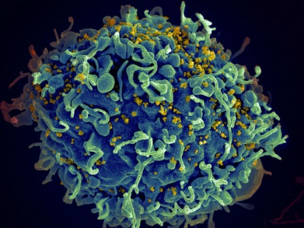
History of HIV and treatment
c. 1910 Emergence of HIV in Congo
1960 Earliest documented cases
1980 AIDS cases identified in US
1984 HIV identified
1986 C. Everett Koop releases surgeon generals report
1987 AZT approved by FDA
1988 First world AIDS Day

Slide 14
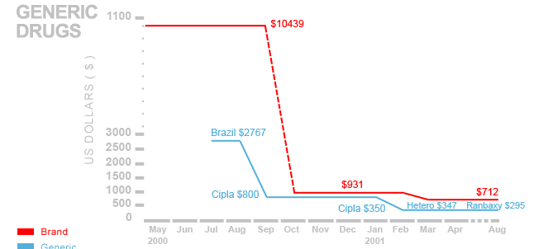
History of HIV and Treatment
1997 HAART Therapy becomes standard in US
2000 Millennium Develop Goals targets end of HIV transmission in 15 years
2001 Indian generic drug manufacture starts development of HIV drugs ($350 per year, vs. $10,500 for branded)
2002 Global fund established, FDA develops framework to allow poor countries to produce HIV drugs
2002 ART started in developing countries
2005 George W. Bush announces PEPFAR, $15 Billion over five years
2008 PEPFAR reauthorized
2010 Greatly expanded use of ARVs in developing countries

Slide 15
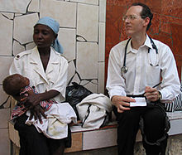
Paul Farmer

Slide 16
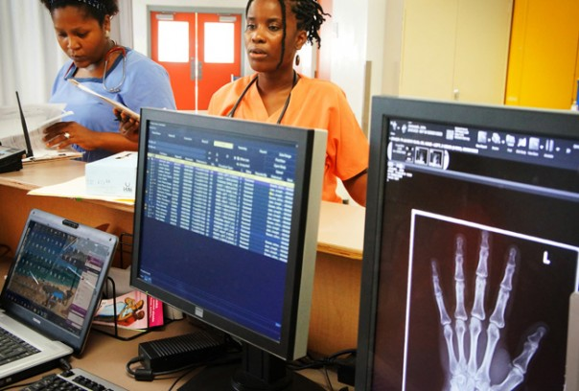
Partners in Health
Founded by Paul Farmer
Initial project, Zanmi Lasante (1987) in Haiti
Expanded to serve central plateau of Haiti, catchment population 1.2 million, employs 4,000 people
Socios En Salud, Lima, Peru (1997)
Community health programs
Large scale TB study
Other countries
Burundi, Malawi, Russia, Rwanda
Often a focus on HIV or TB
Multiple health facilities, large scale training, ties with MOH

Slide 17
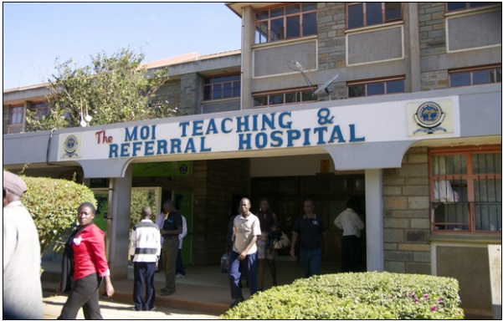
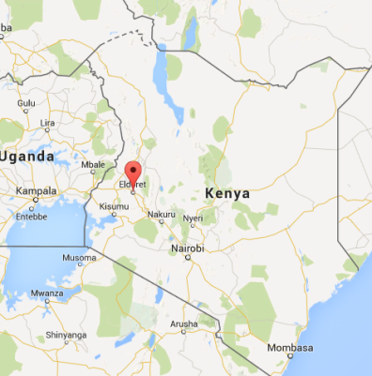
AMPATH
Academic Model Providing Access To Healthcare
Moi University and teaching hospital
Partnership with a consortium of US universities led by Indiana University
Manage health care in hospital/clinics across western Kenya

Slide 18
Basic requirements for a medical record system
Capture information about patient encounters
Vital signs
Test results
Observations and notes tied to medical terminology
Link together encounters by individual

Slide 19
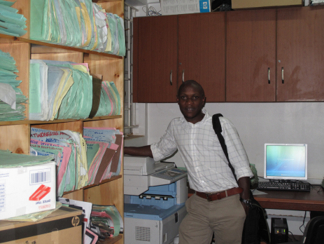
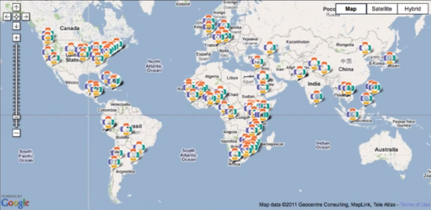
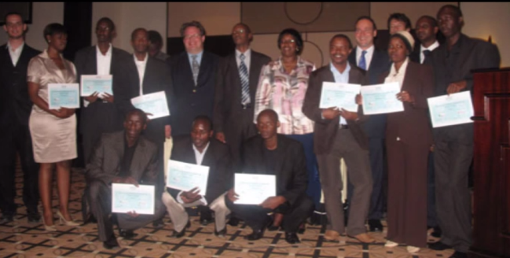
OpenMRS History
Motivated by AMPATH model of using data in treatment
(2004) Modeled after US system (Regenstrief)
Connection with PIH
Started with the data model
Name selected with no reference to Open Source
Launch February 2006 in Kenya
Expanded with real software developers and Google Summer of Code

Slide 20
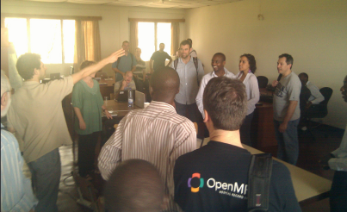
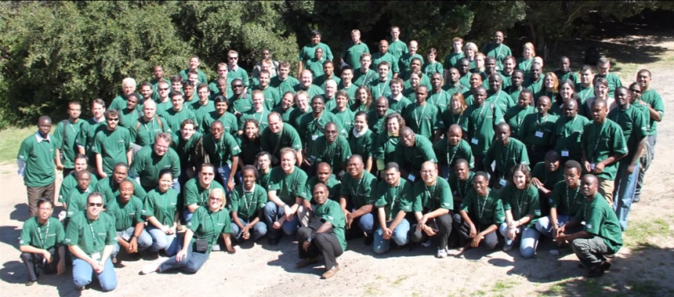
OpenMSR Development
Philosophy of Participatory Design
Ask the doctors what they need
2008 – Rwanda rolls out OpenMRS with local capacity
Formal non-profit organization
A small number of software developers manage and implement key modules

Slide 21
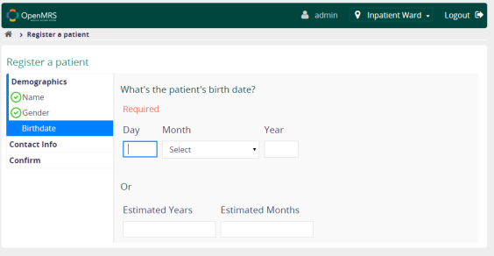
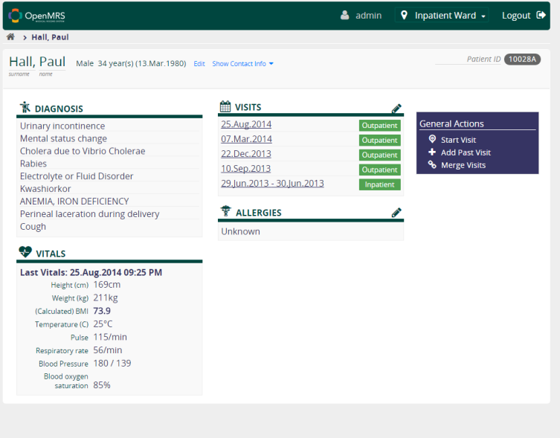
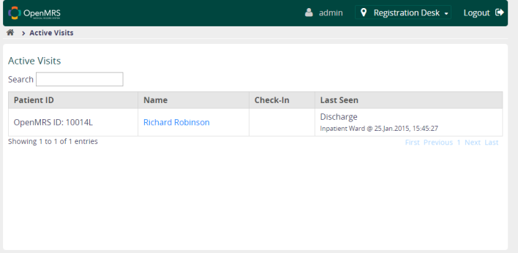
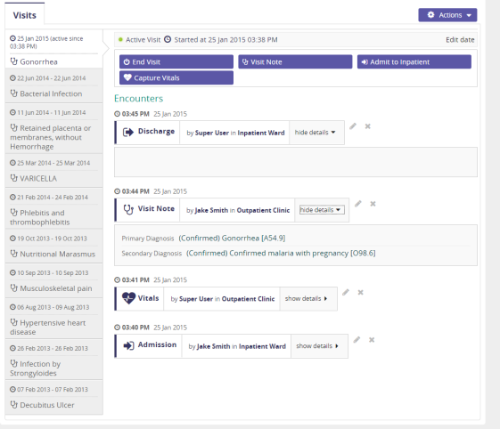
OpenMRS Design

Slide 22
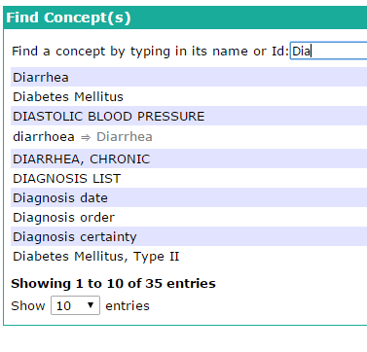
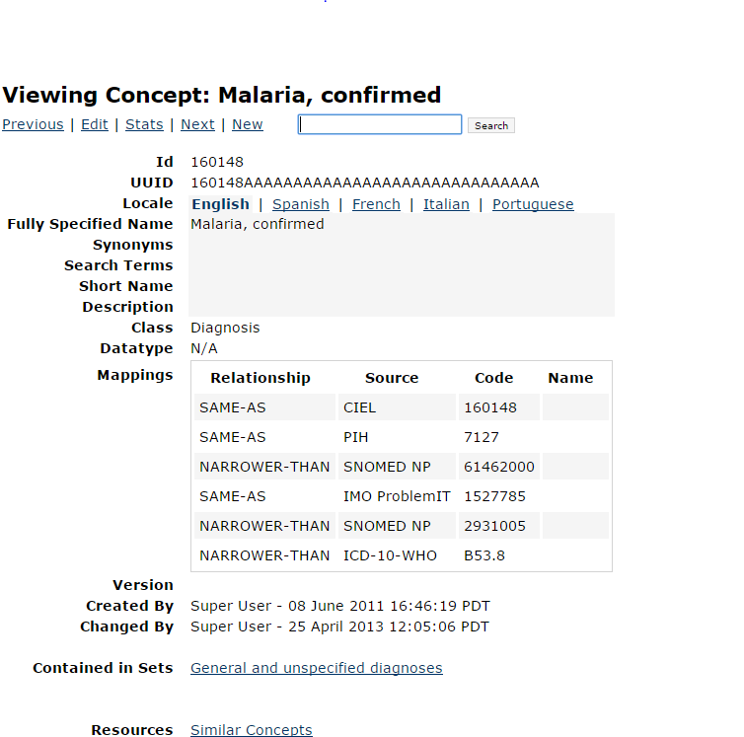
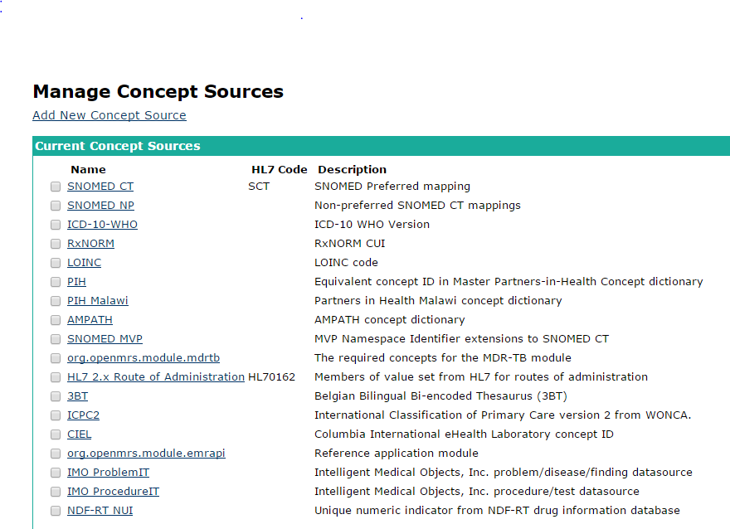
Concepts in OpenMRS
Inclusion of medical ontologies and concept sources

Slide 23
Basic requirements
Capture information about encounter
Vital signs
Test results
Observations and notes tied to medical terminology
Link together encounters by individual

Slide 24
Challenges with OpenMRS
Customization needed for different deployments
Local instances with programmer support
PC and networking infrastructure
Delayed data entry
Data quality
Inconsistent level of use
Patient identity
Identities across different facilities or registrations

Slide 25
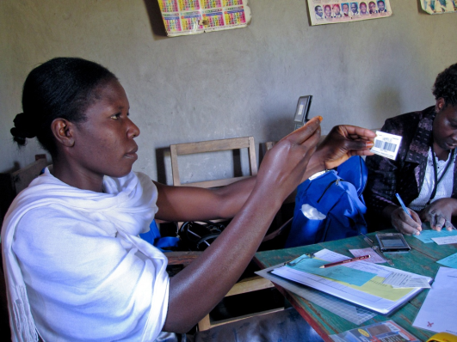
Mobile devices
Should one build a mobile device interface to a medical records system?
Use cases
Patient management (e.g., registration)
Data entry for clinical notes or cases
Access to test results and previous case data
Medication ordering
Clinical alerts
Argument in favor
Mobile devices will have greater availability than computers
Technical challenge: Android application to provide more robust synchronization
Other issues
Security and privacy
UI for small form factor

Slide 26
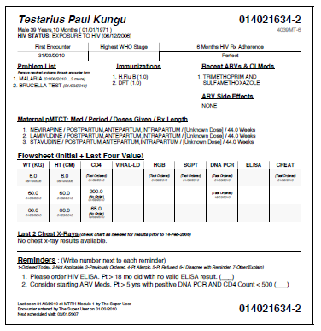
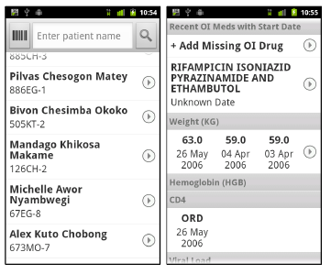
AMPATH deployment of mobile phones and OpenMRS
Use case: Clinical Decision Support Systems
Data available to clinician
Reminders of actions to perform
AMPATH
Paper summaries
Challenges: making summaries available, timeliness of summaries, printing summaries
Solution
Application built on top of ODK for access to OpenMRS

Slide 27
Paperwork
How does use of paper relate to EMR
Completely parallel
Data written on paper, then entered in EMR
Data entered directly in EMR
Level of use of EMR often varies substantially
Inside a facility
Between different facility inside a single system
Over time

Slide 28
Use cases
How is the MRS really used?
Collection of data for external reporting
Collection of data for process improvement
Providing information to clinician during patient care
Providing decision support for clinician
Interface with services

Slide 29
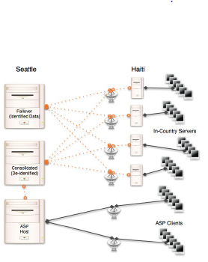
iSante MRS
UW Clinical Research Group / I-Tech
CDC Funded project for EMR in Haiti
Started 2005
Windows IIS application
Roughly 70 clinics in Haiti
Local implementations, with daily backup of all data to a central server
While we subscribe to the widely held opinion that participatory
design is almost essential to the successful adoption of an IT
intervention, the initial requirements for the project were driven
by PEPFAR programmatic needs. S. Wagner et al. [2009]

Slide 30
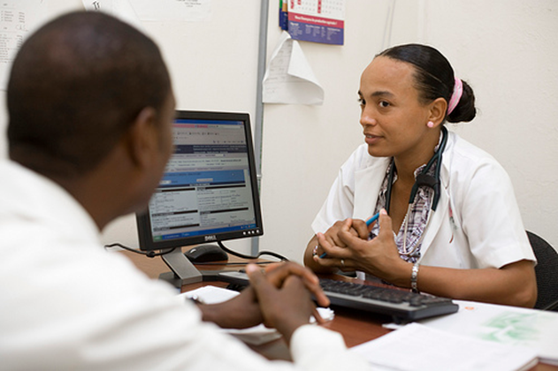
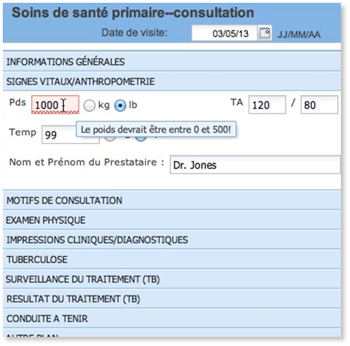
iSante
Key implementation issues:
Infrastructure
Distance between implementers and deployment
Process of continuous development
Focus of the tool is data entry and report generation
Progress when data entry done at patient visit time (as opposed to batch entry later)
Many monthly reports were still tabulated by hand
Uses to improve care: generate lists of missed appointments and people late for medication
Patient privacy
Records restricted to individual clinics
Complications when people moved

Slide 31
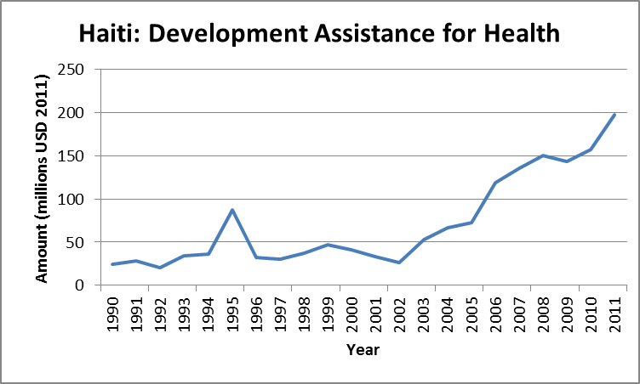
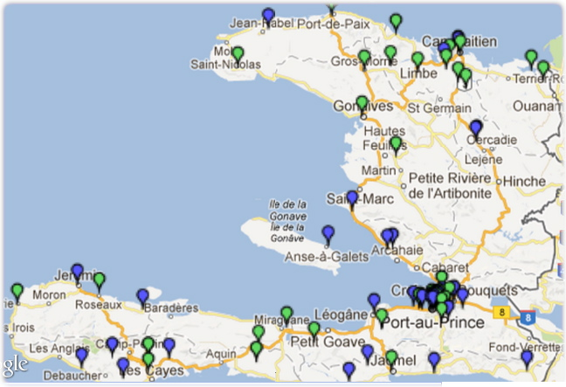
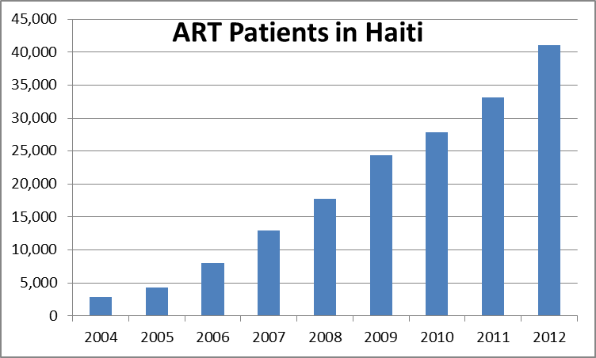
Haiti Context
Expansion of development assistance for health since 1990
Scale-up of HIV antiretroviral therapy (ART)
Scale up of electronic health information systems
Notes:
There are 3 inter-related trends which provide the context for my dissertation topic.
The first is the rapid rise in development assistance for health in recent years. This has opened tremendous potential for improving public health. What the graph does not show is that since 2011, development assistance is leveling off, which of course brings great pressures to optimize quality and efficiency of programs and services.
The second trend is the rapid scale-up of HIV antiretroviral therapy, or ART in Haiti. HIV emerged a major public health concern in Haiti in the 1980s, and as recently as 2005 HIV was responsible for more than one in five adult deaths (22.8%) (IHME, GBD compare). Efforts in the early 2000s to bring ART to patients in rural Haiti demonstrated that this therapy was feasible in low-resource settings, and helped inspire scale-up of ART not only in Haiti but globally. The number of patients placed on ART rose from several hundred in the early 2000’s to 41,000 in 2012.
The third trend is the scale up of electronic health information systems. This has been motivated by an interest in strong acountability for donor funds, a recognition that care for chronic diseases like HIV requires robust tools for longitudinal tracking on patient care, and other factors. The map shows clinics and hospitals where the iSante EMR is deployed in Haiti. This is the data source for my dissertation. Key: Green = local server; Blue = on-line server

Slide 32
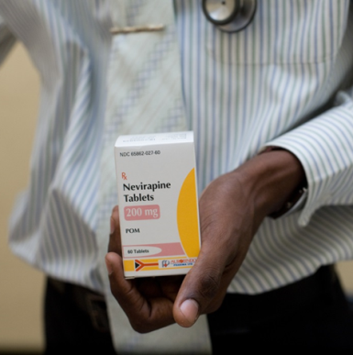
ART Adherence
Relationship between HIV antiretroviral therapy (ART) adherence and HIV viral suppression is well-established
Second-line ART regimens are expensive and not widely available
No perfect measures of ART adherence
Self reported adherence
Pharmacy data (considered accurate in iSante)

Slide 33
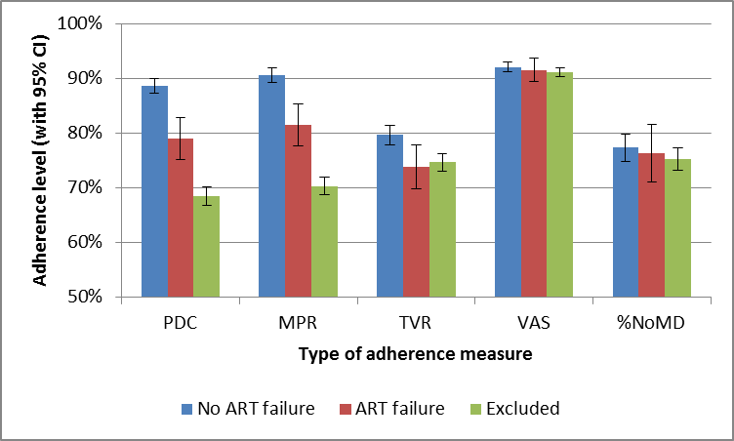
I-Tech Study
Compare pharmacy and self-report measures of adherence
Adherence measured by CD4 count
Result
Pharmacy data a far stronger predictor
Use
High risk patients can be given extra counseling
PDC, MPR: Pharmacy data
VAS, NoMD: Self-report

Slide 34
Medical Record Systems – Random thoughts and questions
Is the developing world MRS problem the same as the developed world MRS problem?
Is the key problem just keeping networked PCs up and running in a facility with poor infrastructure and limited IT support?
What is the level of technical support necessary to run OpenMRS in a network of health facilities?
Will OpenMRS be around in 10 years?
How to do Medical Record Systems tie into the agendas of different ICT and Global Health organizations?

